Slide 1
PROPOSED CONVENTION CENTRE AT LAKSHMI SPINNING MILLS
trestle consulting
T-05, 3rd Floor Gold signature Mosque Road,
Frazer Town Bangalore-560005

Slide 2
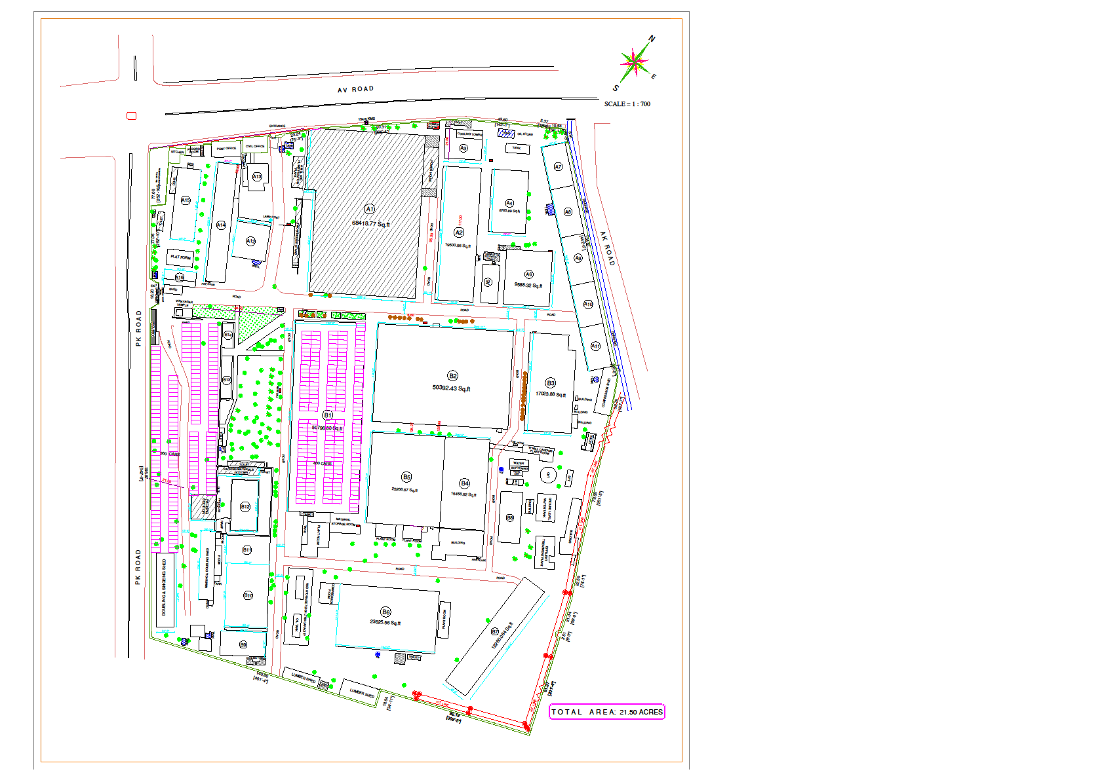
Structure in
consideration
Parking for 360 cars
Parking for 400 cars
Total area of shed A1 68418 Sft
1. PROPOSED REMODELLING AND PARKING LAYOUT

Slide 3
Factors impacting electricity consumption of Air Conditioner,
There are 4 factors that influence the electricity load:
Indoor air temperature
Outdoor temperature
Temperature setting of the air conditioner.
Thermal insulation of the room
As per study by ACEEE (American Council of Energy Efficiency Economy),
increase of each degree centigrade of temperature of thermostat setting can save 3-5% of units consumed.
This can considerably bring down the units consumed per month in the electricity bill for Air conditioning.
If we can reduce the ambient temperature inside the building by 10 degrees ,we can bring down the electricity consumption of air conditioning by nearly 50 percent, which is nearly 350kva in our case.
therefore we propose the following to reduce the ac loads.
bringing down the inside ambient temperature by means of water bodies ,landscaping , vertical gardens
Cooling the air or breeze entering the building by venturi effect – i.e making the air pass through small openings which further cools the air .
generally, the rooftop solar radiation causes 50% of the heat load in any premises , this heat gain can be reduced by ventilating the undersurface roof by solar vent fans and painting the roof with white reflective paint.. Some industries cool their roofs with evaporation of water over their roof.
water sprinkling during peak hours of day and other such methods were tried earlier.
But if water could be re-used, similar method could still be tried out.
This tends to bring down temperature under the roof, by say 5 to 10 degrees or more.
INTERGRATED SYSTEM FOR THERMAL TEMPERING

Slide 4
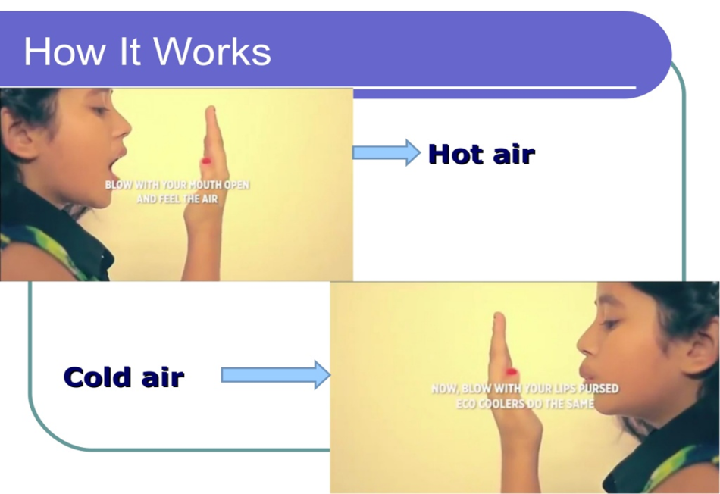
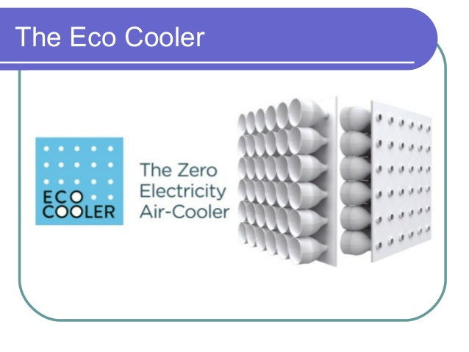
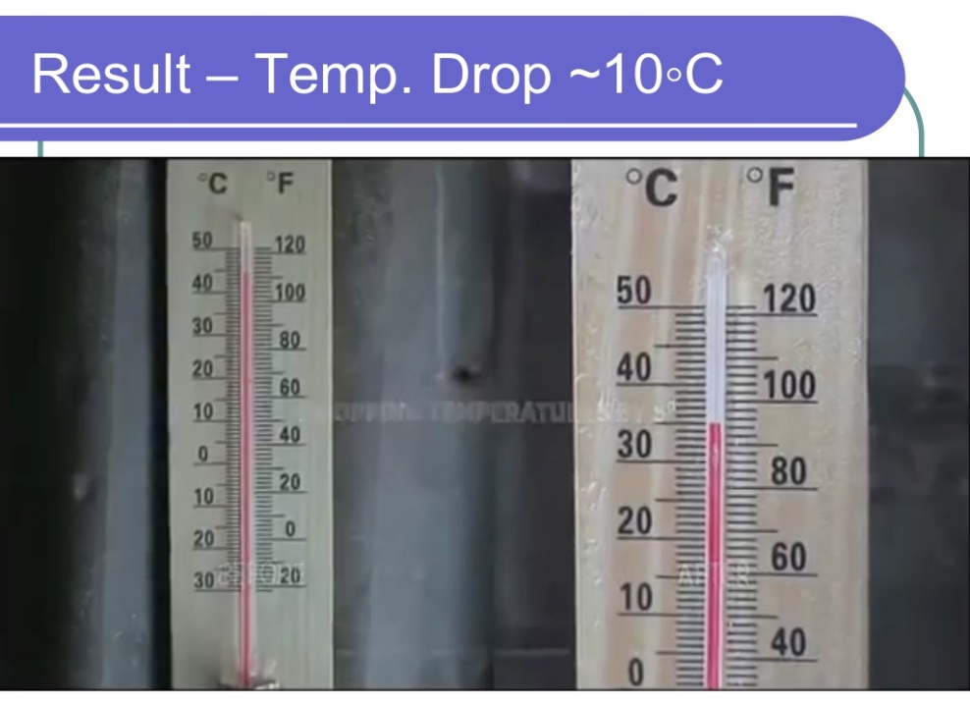
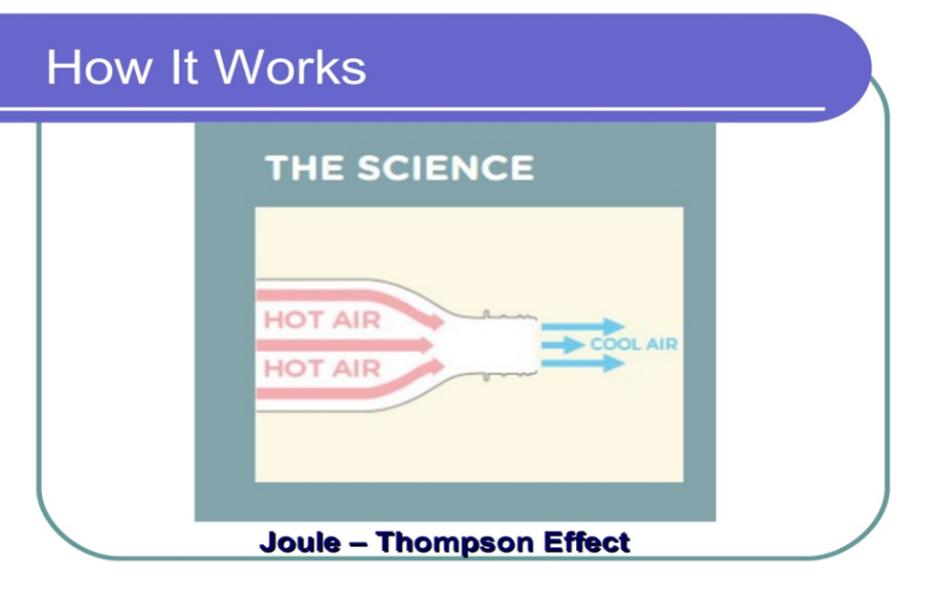
VENTURI EFFECT
METHODS TO COOL THE AIR /BREEZE

Slide 5
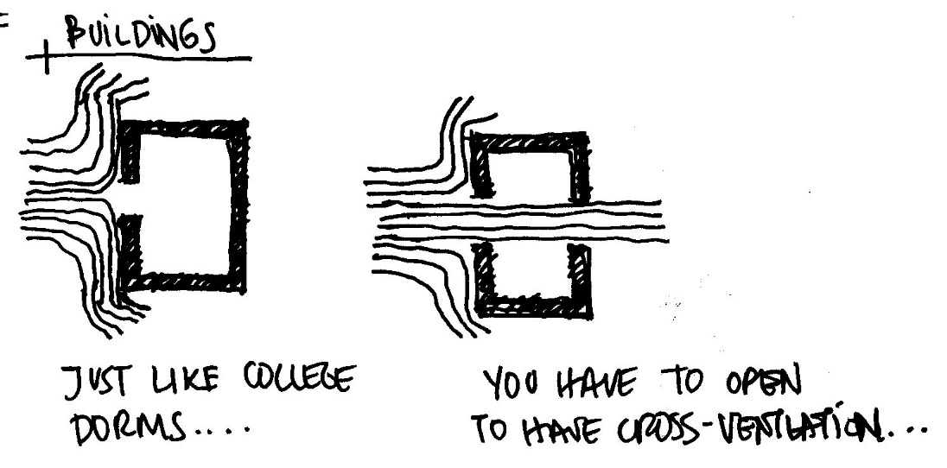
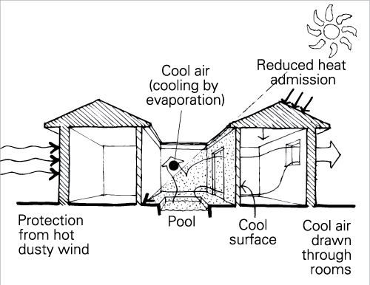
METHODS TO COOL THE AIR /
BREEZE - CROSS VENTILATION
AND USE OF WATER BODY

Slide 6
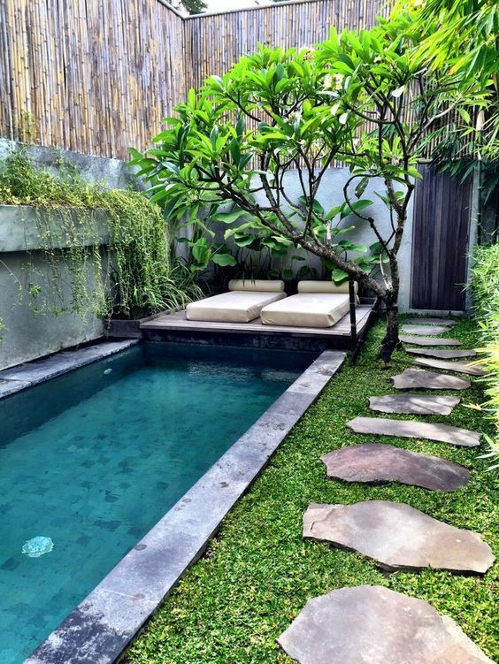
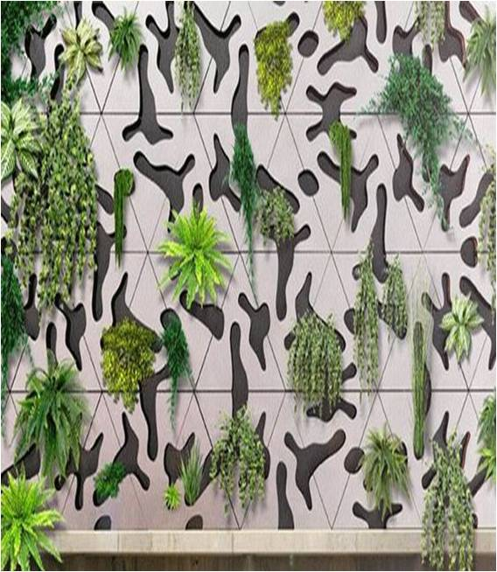
VERTICAL LANDSCAPE
WATER BODIES
THERMAL TEMPERING BY USING
VERTICAL GARDENS AND LANDSCAPING

Slide 7
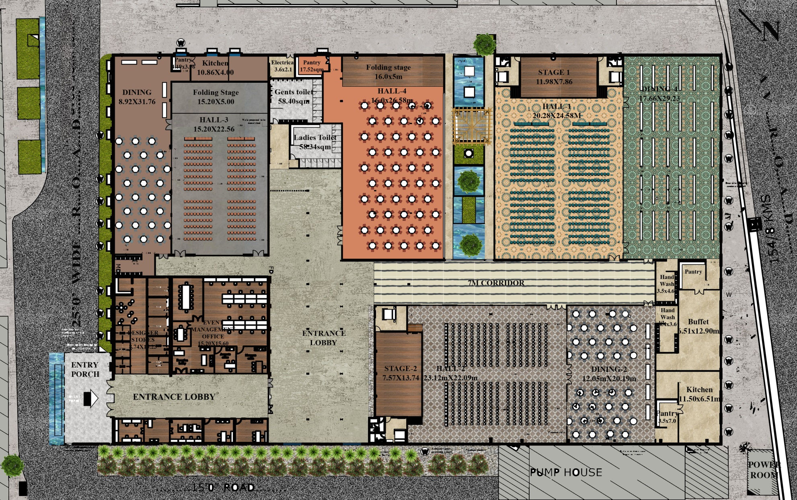
OPTION-I
HALL-1 - 1500-1800 HALL-2 - 1300-1500
HALL-3 - 800-1000 HALL-4 - 325-600

Slide 8
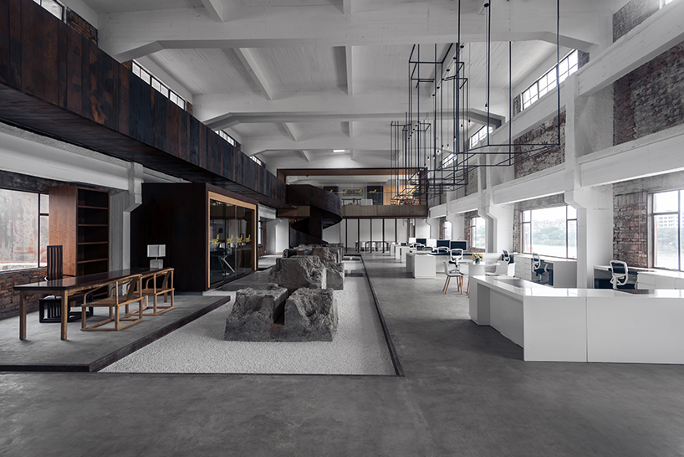
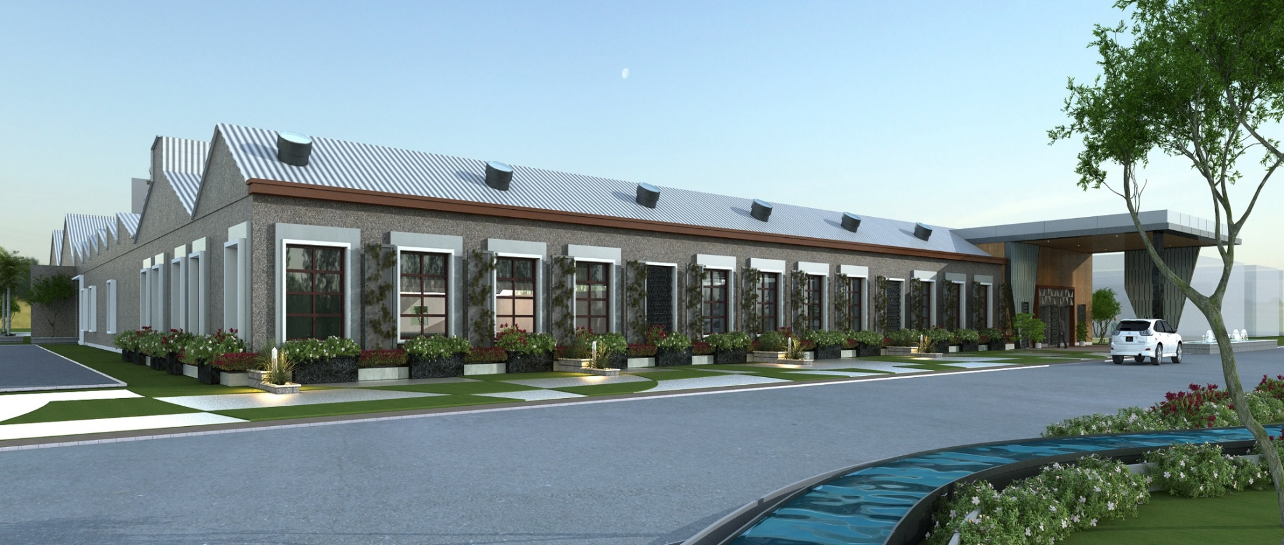
CONCEPT FOR COFFEE SHOP AND DESIGNER STORES

Slide 9
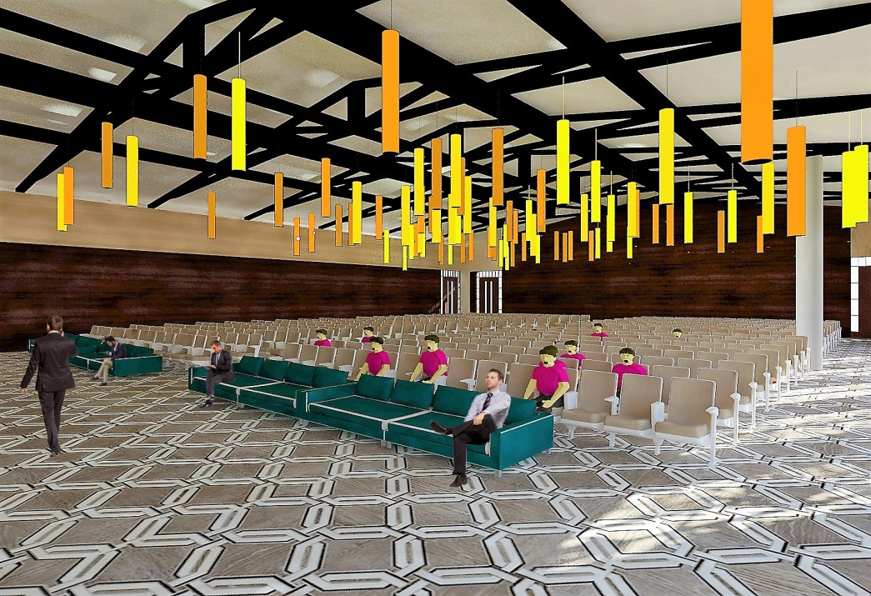
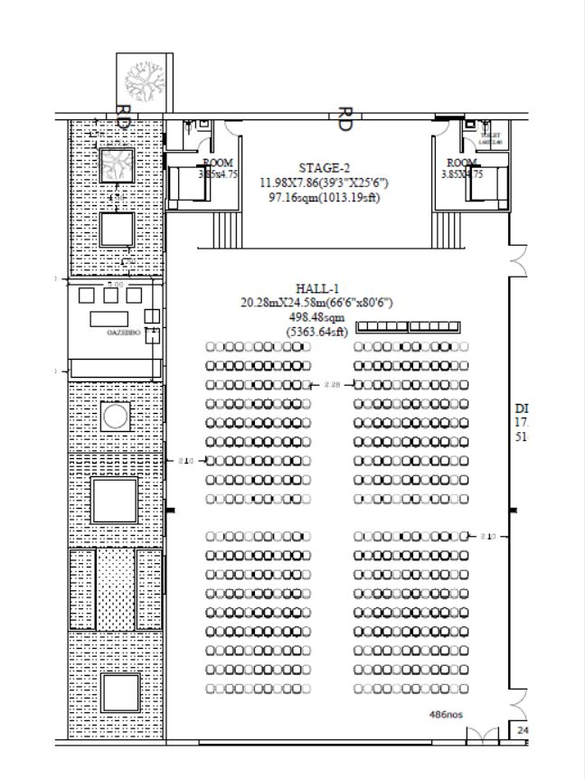
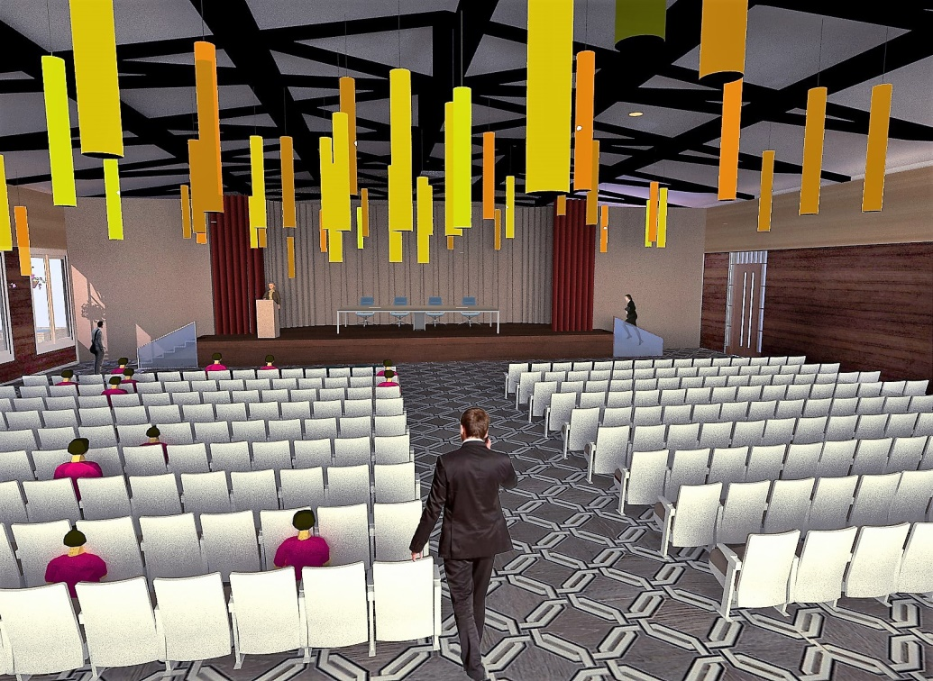
VIEW FROM STAGE CORNER
PLAN HALL 1
CONCEPTS FOR HALL
VIEW FROM AISLE

Slide 10
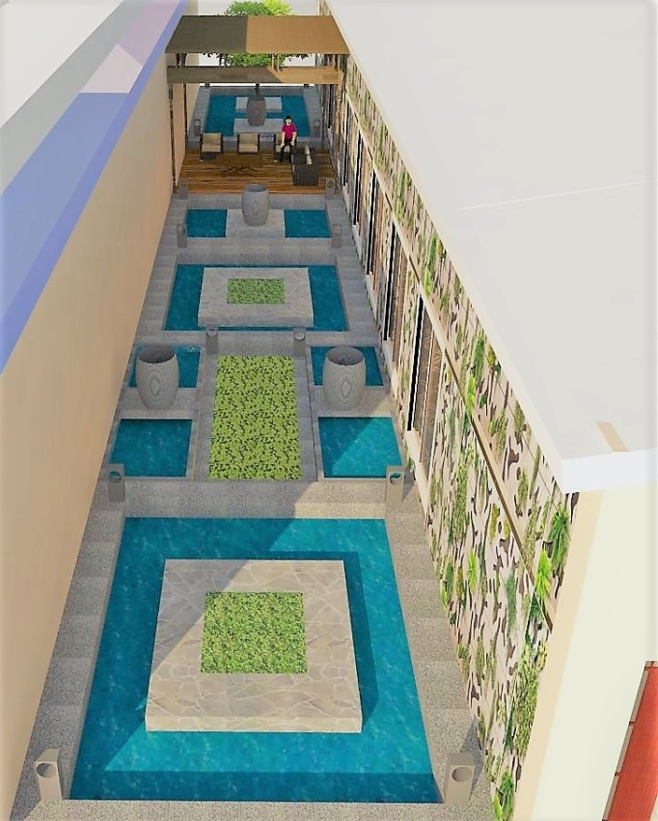
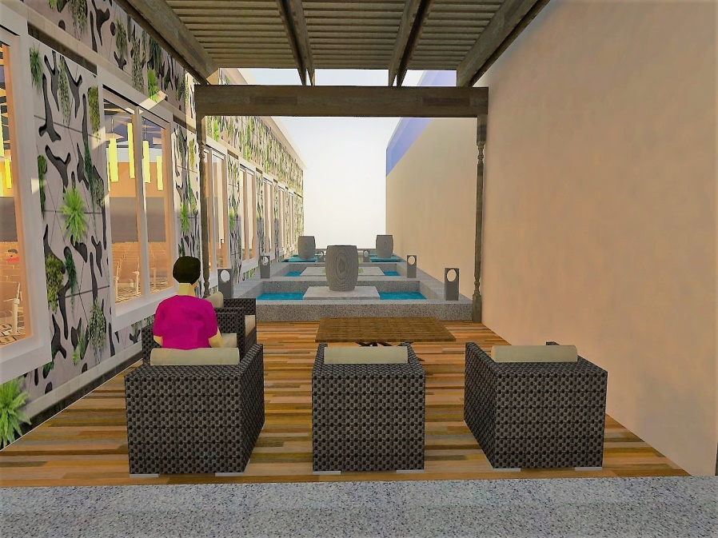
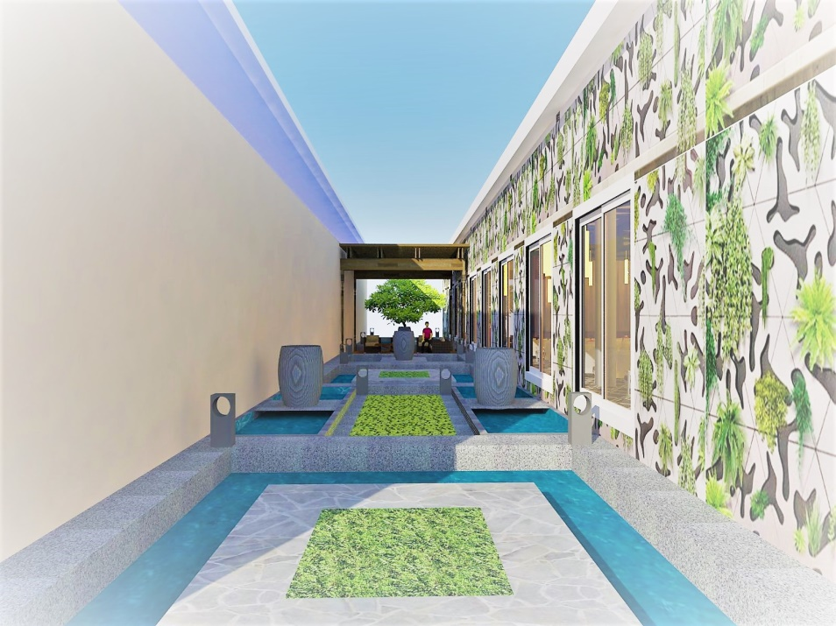
WATER BODY AS DESIGN FEATURE AND FOR THERMAL TEMPERING

Slide 11
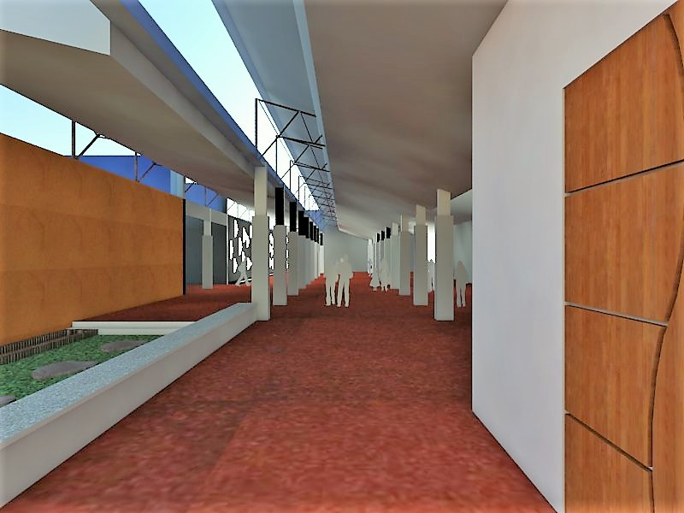
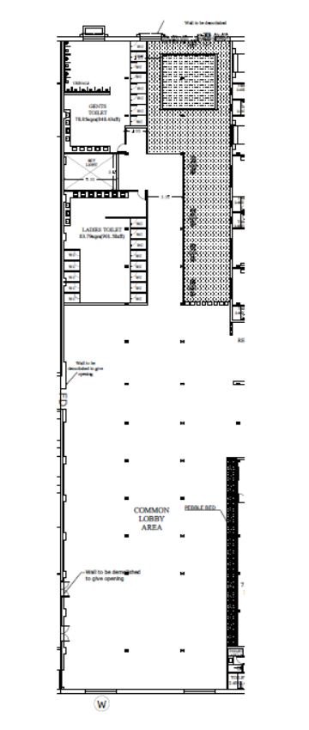
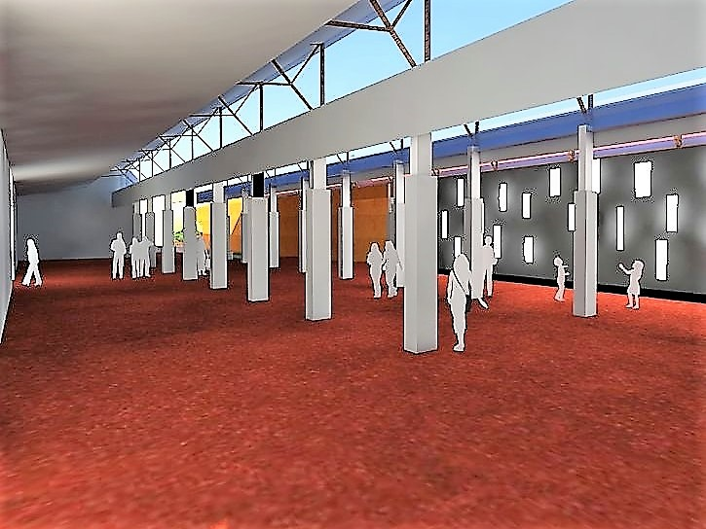
CONCEPT FOR COMMON CORRIDOR
CORRIDOR PLAN

Slide 12
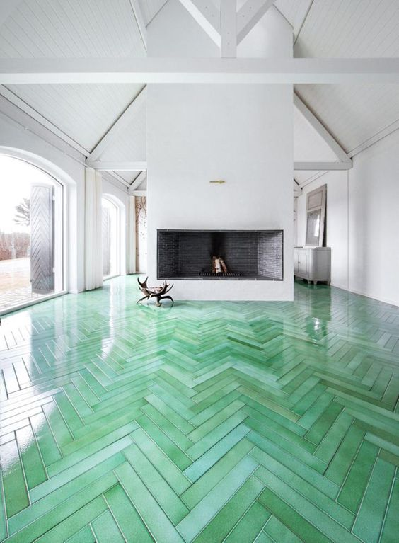
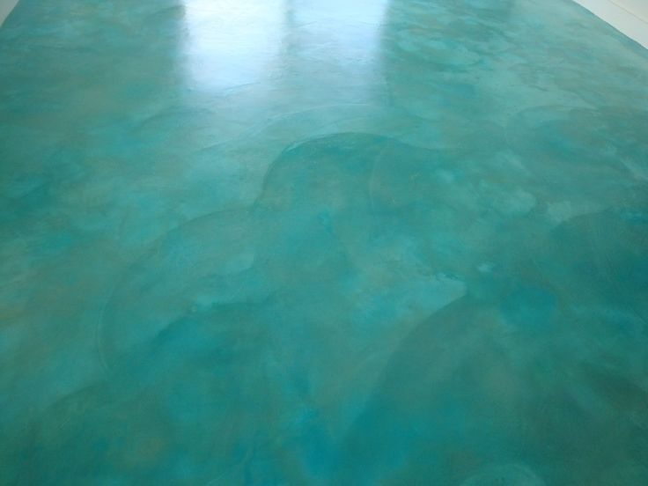
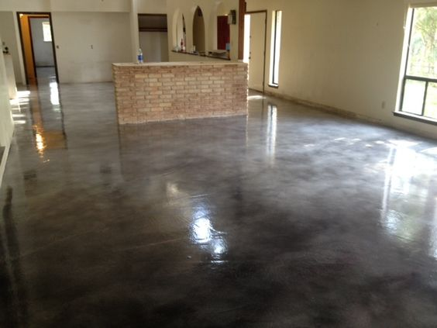
FLOORING OPTIONS
1.STAINED AND POLISHED CONCRETE FLOORS
Acid stained 2
Acid stained 1
Acid stained 3

